Slide 1
Google Translate
API Project By:
Jakolbi Wilson & …………….

Slide 2
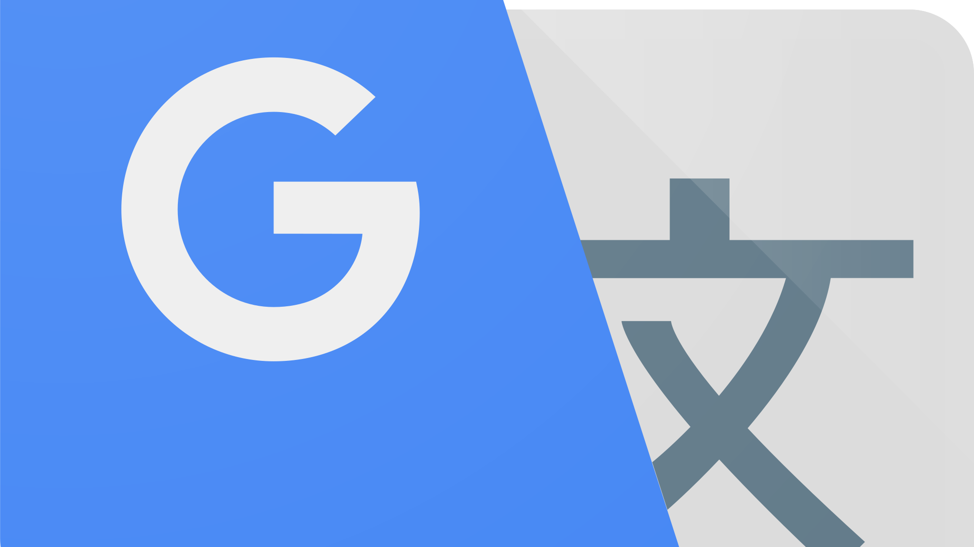
This Photo by Unknown Author is licensed under CC BY-SA

Slide 3
What is it?
What is Google Translate. Google Translate is a free online language translation service that can instantly translate text and web pages between any language pairs.
With over 100 billion words translated per day, it's a tool that has become an essential part of the modern-day communication landscape.
Google Translate is a form of API like many others out there.

Slide 4
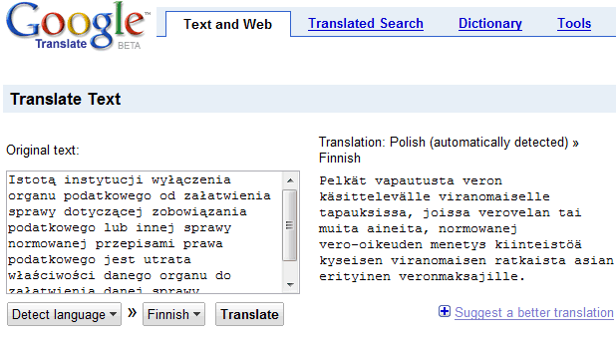
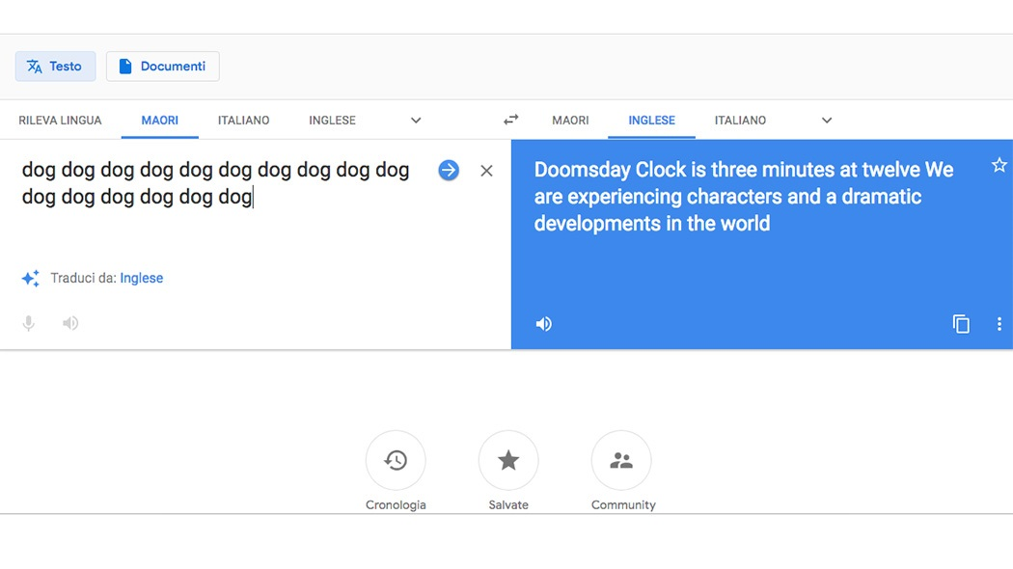
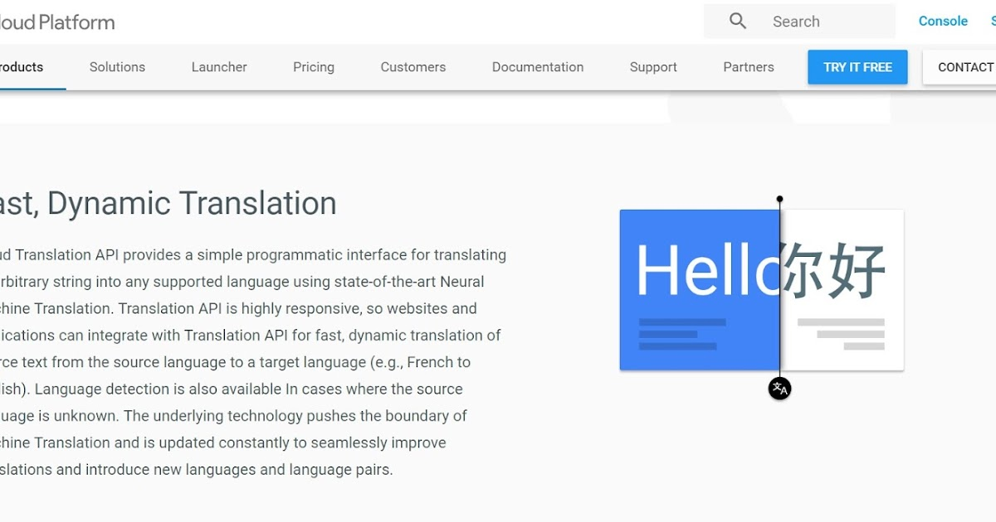
This Photo by Unknown Author is licensed under CC BY
This Photo by Unknown Author is licensed under CC BY
This Photo by Unknown Author is licensed under CC BY-NC-ND
This Photo by Unknown Author is licensed under CC BY

Slide 5
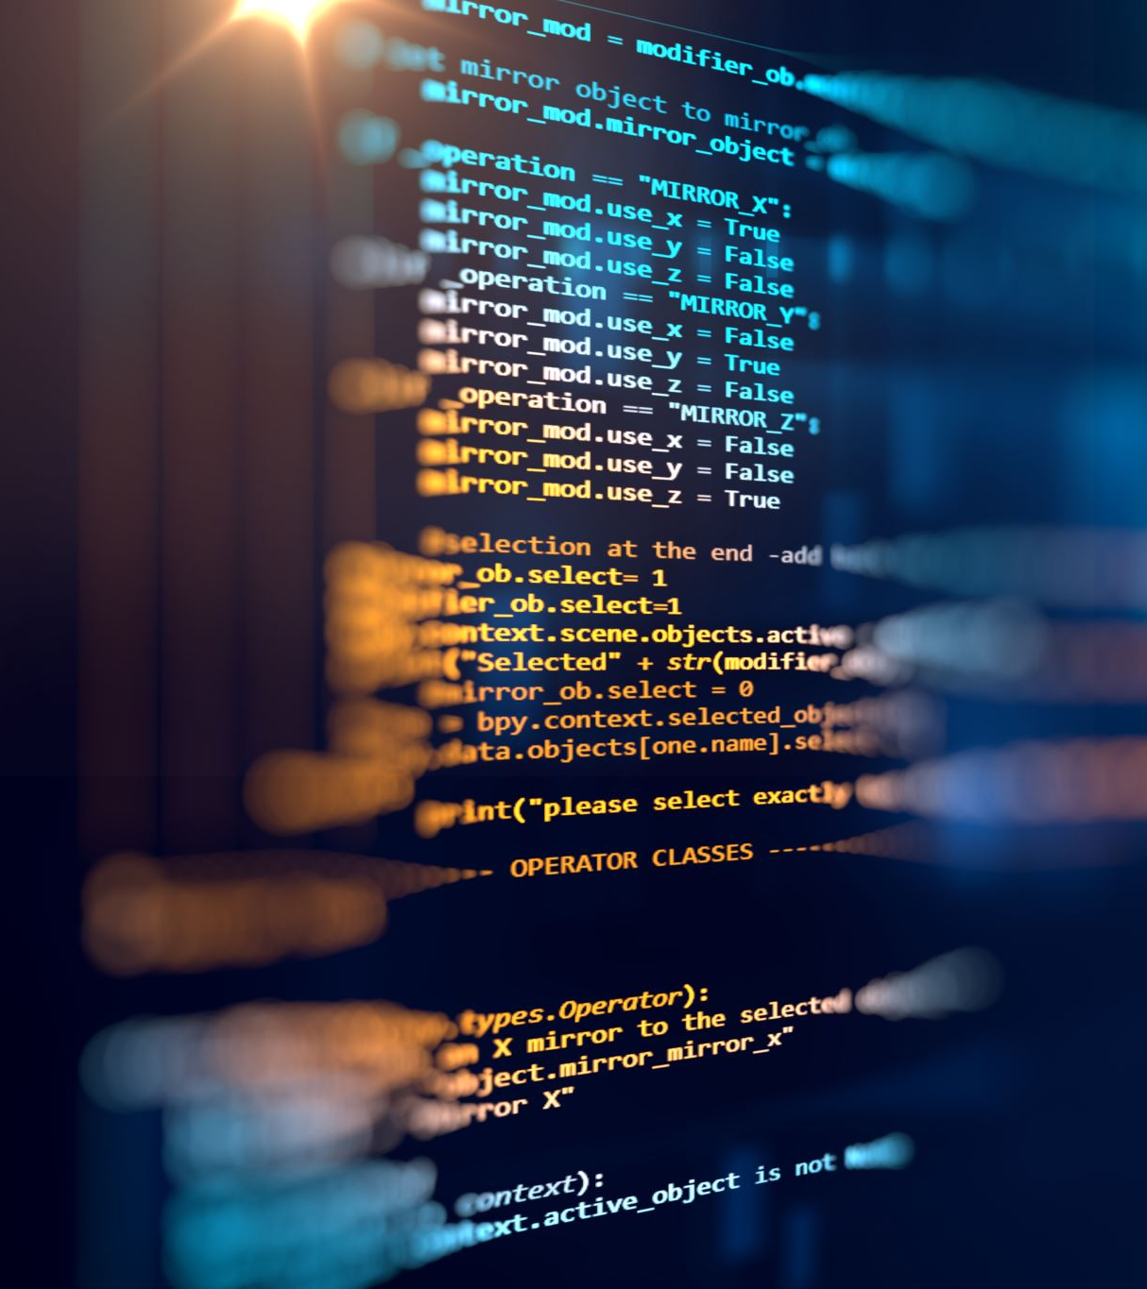
What is an API?
API stands for "Application Programming Interface".
It's a set of protocols, tools, and routines for building software applications that allow two different applications to communicate with each other.
In other words, it's a way for different software programs to talk to each other and share data.

Slide 6
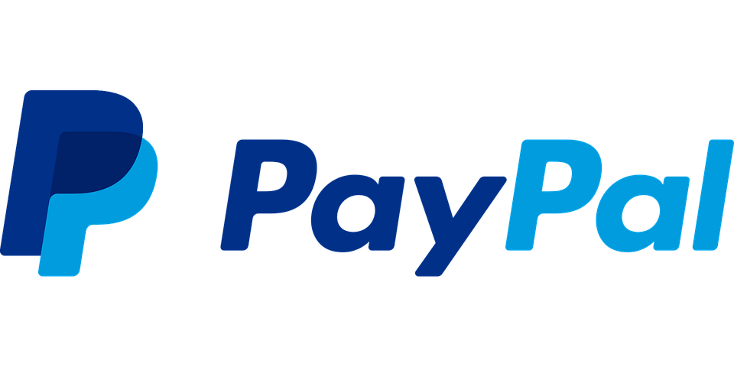
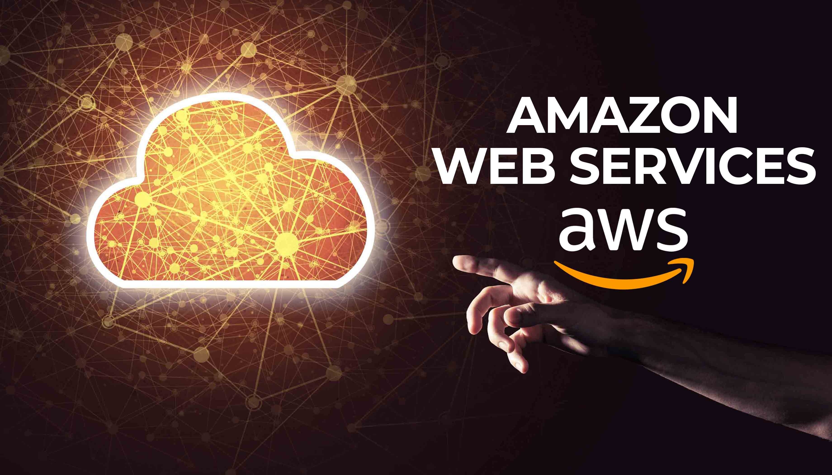
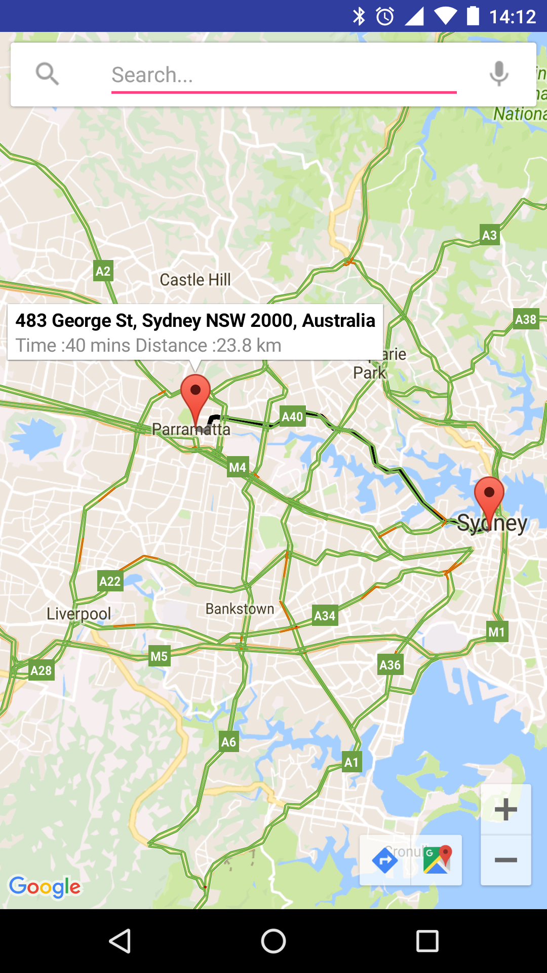
Forms of API’s
Social media APIs: Social media platforms like Facebook, Twitter, and LinkedIn offer APIs that enable developers to integrate their platforms' features into their own applications. These APIs allow developers to access users' data, post updates, and interact with other users.
Payment APIs: Payment gateways like PayPal and Stripe offer APIs that enable developers to accept payments in their own applications or websites. These APIs provide developers with a secure way to process payments and manage transactions.
Mapping APIs: Mapping APIs like Google Maps, MapQuest, and Bing Maps provide developers with the ability to display maps, geocode addresses, and calculate directions within their applications. These APIs are commonly used in location-based services, navigation, and logistics applications.
Cloud APIs: Cloud APIs like Amazon Web Services (AWS) and Microsoft Azure provide developers with access to cloud-based computing resources. These APIs allow developers to create and manage virtual machines, databases, and storage, among other things.
These are just a few examples of the different forms or applications that are popular APIs. With the rise of the API economy, we can expect to see more and more innovative use cases for APIs across a range of industries in the future.

Slide 7
This next slide will inform you a bit about the process for testing new API.

Slide 8
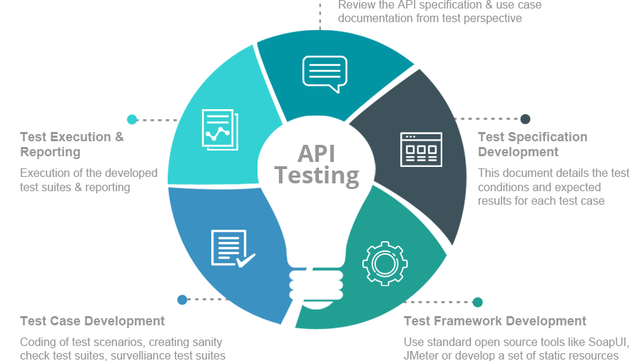
This Photo by Unknown Author is licensed under CC BY-SA

Slide 9
Google’s Form of API
The Google Translate API is a cloud-based service that enables developers to integrate automatic translation into their applications or websites.
The API can be used to translate text in real-time or translate large volumes of text in bulk.
One of the key advantages of the Google Translate API is that it's powered by Google's advanced machine learning technology. This means that the translations produced by the API are more accurate and natural-sounding than ever before.
Google Translate uses neural machine translation, which is a form of AI that uses deep learning algorithms to learn from vast amounts of data to generate more accurate translations.
The Google Translate API supports over 100 languages and offers a range of customization options for developers.

Slide 10
How or when is it used?
The Google Translate API has a wide range of use cases. For example, it can be used by e-commerce websites to automatically translate product descriptions and customer reviews into multiple languages.
This can help businesses expand their customer base and increase sales. The API can also be used in the travel industry to translate websites, menus, and signage for tourists
Additionally, it can be used by language learning apps to provide users with accurate translations of words and phrases.

Slide 11
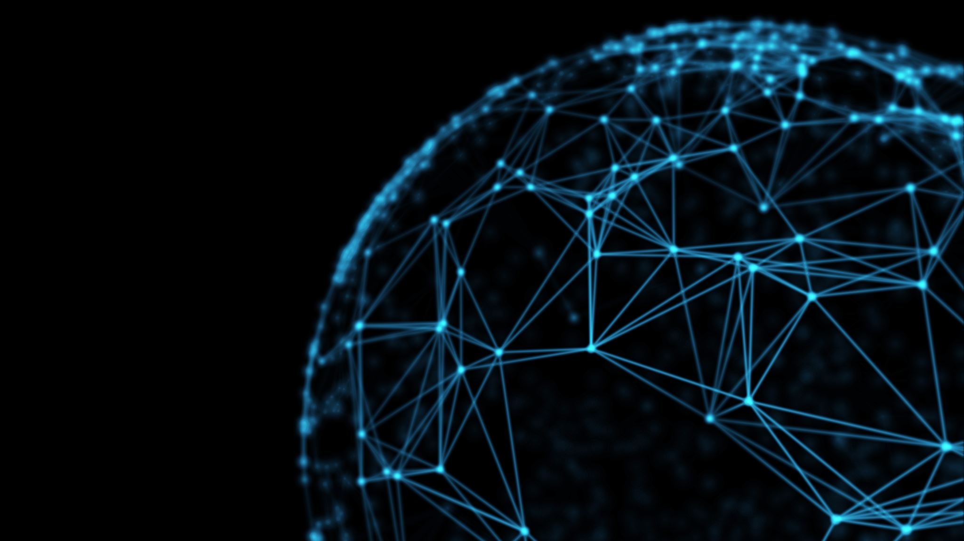
Google is Powerful
In conclusion, The Google Translate API is a powerful tool that enables developers to add automatic translation capabilities to their applications or websites.
With its advanced machine learning technology and support for over 100 languages, the API has become an essential part of the modern-day communication landscape.
As we continue to see an increase in globalization and digitalization, it's clear that the Google Translate API will play a vital role in breaking down language barriers and bringing people closer together.

Slide 12
THE END

